Slide 1
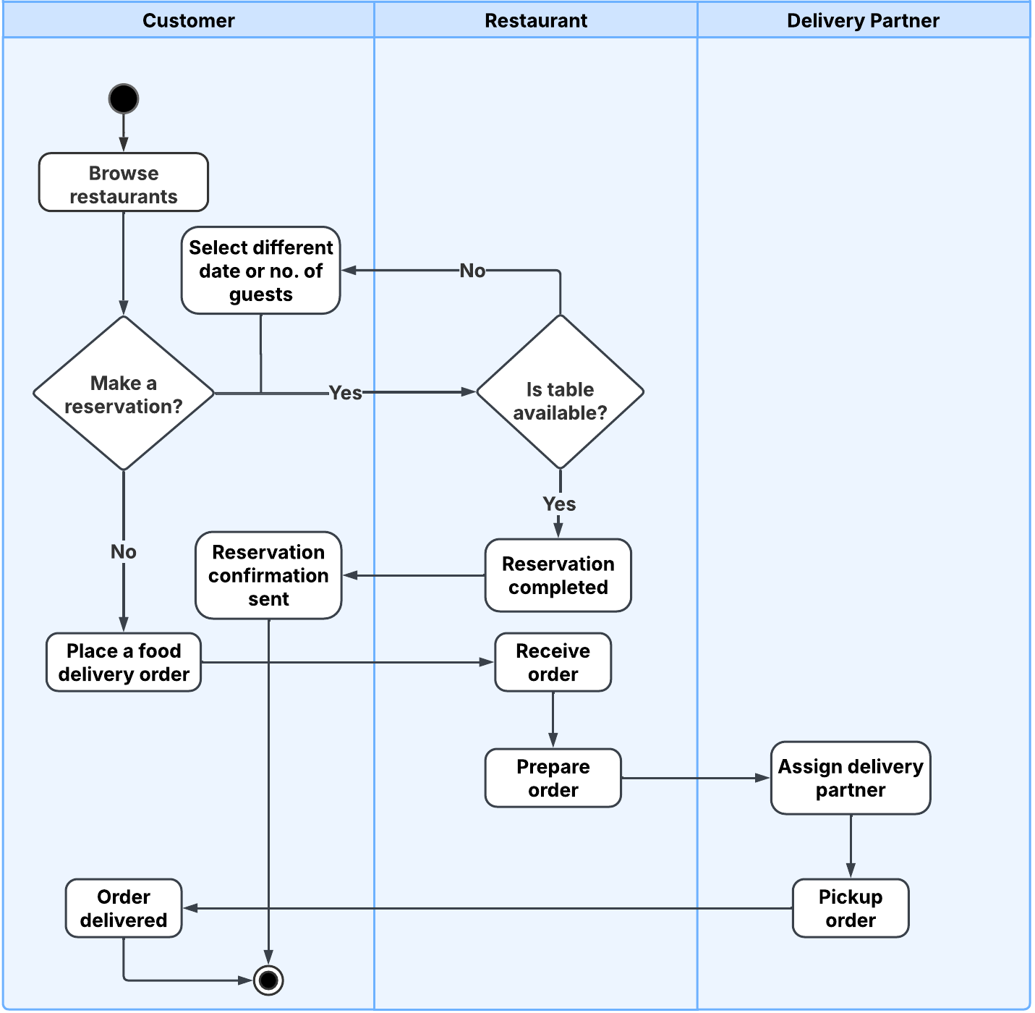
Activity Diagram : DineDash

